Slide 1
Pandas data structures
Notes:
[Mandatory Slide] This would be the introduction slide of the topic that you are covering in this subsection.
When this slide plays, you could talk about the main aim that we’d be covering in this video.

Slide 2
In this Video, we are going to take a look at…
What is Pandas?
Pandas data structures
Code sample: playing with Pandas data structures
Notes:
[Mandatory Slide]
Before the start of the video, we’d like to highlight what are important topics or pointers that we’d be covering in this video. This slide would immediately follow the intro/name slide. This would just be say 2-3 points for the viewers to know what they are getting into.

Slide 3
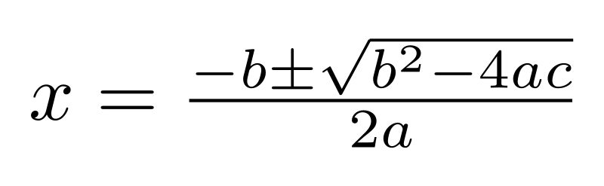

What is Pandas?
Pandas is an open-source Python library providing high-performance data manipulation and analysis tools
based on NumPy, a library for doing serious maths with Python
has great community support and is the foundation for many other libraries
extremely versatile and can be used for quickly reading, cleaning and wrangling also big datasets
can input/output data from loads of local/remote data sources
Install Pandas with: pip install pandas
as Pandas requires NumPy to be compiled, make sure you have a compiler configured on your platform (see the docs at https://pandas.pydata.org/pandas-docs/stable/install.html)
Notes:
[Mandatory Slide]
Before the start of the video, we’d like to highlight what are important topics or pointers that we’d be covering in this video. This slide would immediately follow the intro/name slide. This would just be say 2-3 points for the viewers to know what they are getting into.

Slide 4
Pandas datastructures
Pandas has two important types of datastructures: series and dataframes
Series are 1-dimensional “labelled” arrays
the label is called “index” and is used to access each element
you can build series from Python lists or dicts
series can be extended, sliced, sorted, added, multiplicated...
0
1
2
3
Dataframes are 2-dimensional “labelled” matrices
think of it like CSV files or spreadsheets
you can build dataframes from dicts of Series objects, dicts of dicts or list of dicts
Dataframes can be sliced by columns/rows, sorted, added, multiplicated, transposed…
Dataframes provide embedded statistical summaries
A
B
C
D
0
1
2
3
4
Notes:
[Mandatory Slide]
Before the start of the video, we’d like to highlight what are important topics or pointers that we’d be covering in this video. This slide would immediately follow the intro/name slide. This would just be say 2-3 points for the viewers to know what they are getting into.

Slide 5
Code Sample: playing with Pandas data structures
Notes:
Something that needs to grab the viewers attention!!

Slide 6
Summary
What is Pandas?
Pandas data structures
Code sample: playing with Pandas data structures
Notes:
[Mandatory Slide]
Before the start of the video, we’d like to highlight what are important topics or pointers that we’d be covering in this video. This slide would immediately follow the intro/name slide. This would just be say 2-3 points for the viewers to know what they are getting into.

Slide 7
Reading and writing datasets
Next Video
Notes:
[Mandatory Slide]
Here the name of the next video needs to be mentioned. The narration as you guessed it would be just letting the viewer know exactly where we are at and what we’d be taking over next! ☺

